Slide 1





















BARTIK100
2nd International Conference
NETWORKS, INTELLIGENCE AND COMPUTING (ICONIC-2024)
Presented By :Gundabathini Abhiram Time : April 26-27 , 2024
Paper ID : ICONIC-208
Venue: Lovely Professional University Jalandhar-Delhi, G.T. Road, Phagwara, Punjab, INDIA

Slide 2
Detecting Cyberbullying:
Integrated Approach Using Machine Learning and Deep Learning Models on Social Media Platforms
Gundabathini Abhiram Nidhi Sharma
B Srinivasa Rao Aditya Raj Jha
Voora Satya Vighnesh Maturi Snehith Kumar Dharshan Raj
Department of Computer Science & Engineering
Lovely Professional University, Punjab | 2024

Slide 3



CONTENTS
01
02
03
04
05
ABSTRACT
INTRODUCTION
LITERATURE SURVEY
RESEARCH GAPS
OBJECTIVES
06
07
08
09
DATASET COLLECTION
METHODOLOGY
RESULTS
CONCLUSION
10
FUTURE SCOPE
11
REFERENCES

Slide 4
ABSTRACT
Our study presents an integrated approach for detecting cyberbullying on social media platforms by combining machine learning and deep learning models.
By utilizing a diverse dataset, we train models to identify cyberbullying patterns with high accuracy.
01
03
₀₄ online environments through advanced technology.
02
Our approach leverages language processing interactions.
the strengths of natural
to analyse text-based
Our findings contribute to the development of safer
05
The hybrid approach allows for a more robust and adaptable detection system, offering potential for real-time implementation.

Slide 5

INTRODUCTION
In our Modernized era, social media has become an integral part of daily life, facilitating instant communication and information sharing among billions of users worldwide.
The digital landscape confronts cyberbullying, a pervasive threat to emotional well-being, transcending borders and occurring unpredictably on digital platforms.
Our study uses ML techniques like SVM, Logistic Regression, and Naïve Bayes classifiers to automatically detect cyberbullying in diverse linguistic contexts, enhancing detection and response in digital environments.
Throughout this presentation, we will explore the efficacy of these algorithms in identifying and addressing cyberbullying behaviors across various online platforms and languages, highlighting the transformative potential of machine learning in combating online harassment.
In this project, Cyberbullying detection is done on the language of Telugu. We have incorporated our own Telugu dataset collected from various sources.

Slide 6




LITERATURE SURVEY
Paper Title
Objective
Technique Used Research Outcomes
Limitations
"CONTEXT-AWARE CYBERBULLYING DETECTION USING BERT"(2024)
Achieved significant improvement in
Computationally intensive due to large models. Limited by the need for extensive labelled data for fine- tuning
To leverage contextual information for better cyberbullying detection
Bidirectional Encoder Representations from Transformers (BERT), Contextual Embeddings, Transfer Learning
contextual understanding of cyberbullying content. Detected
nuanced cases of cyberbullying with higher accuracy.
To improve interpretability
Explainable AI (XAI), Decision Trees, LIME (Local Interpretable Model- agnostic Explanations
Provided insights into model decision- making processes. Improved transparency in cyberbullying detection.
Trade-off accuracy.
between explainability and May require additional
"EXPLAINABLE AI FOR CYBERBULLYING DETECTION"(2024)
and explainability of cyberbullying detection models
resources for implementing explainable AI techniques.
Significantly
cyberbullying accuracy compared to
To develop an cyberbullying system
efficient detection
Long Short-Term Memory (LSTM)
improved
Reliance training Difficulty
on large datasets for
"CYBERBULLYING DETECTION USING DEEP LEARNING TECHNIQUES" (2018)
Networks, Word2Vec, Recurrent Neural Networks (RNN)
detection traditional
deep learning models.
machine learning
in interpreting decisions
approaches. Effective in capturing contextual information in a text.
made by deep learning models.
Successfully identified cyberbullying
Limited by the challenge of handling large volumes of streaming data in real time. Dependency on manually labelled datasets for training.
"DETECTING CYBERBULLYING IN ONLINE SOCIAL NETWORKS USING MACHINE LEARNING TECHNIQUES" (2019)
To detect cyberbullying in online social networks
Graph-based techniques, Community Detection Algorithms, Logistic Regression
instances within online social networks.
Detected cyberbullying patterns across interconnected users.
"HYBRID MODEL FOR CYBERBULLYING DETECTION IN SOCIAL MEDIA" (2019)
To develop a hybrid model for cyberbullying detection
Ensemble multiple
Learning classifiers),
(Combining Text Mining,
Excelled in cyberbullying detection
Challenges in model integration and potential computational overhead for real-time deployment.
with advanced ML heightened accuracy.
integration for
Decision Trees

Slide 7






RESEARCH GAPS
I
In preceding research, the lack
of studies addressing
cyberbullying in the Telugu
II
Despite a significant amount of
language highlights the need for additional research and
research being conducted on various languages, the available datasets were primarily in English,
investigation in this area.
III
Hindi, Bengali, and other
A dataset comprising comments in the Telugu language transliterated into English text has not been utilized in any study.
languages, and were limited to specific subsets of tweets on Twitter.

Slide 8

OBJECTIVES
Secure Social Media
Dataset Incorporation
Detection Using ML
Implementation
To enable a healthy messaging platform, that can prevent
To detect the Telugu vulgar comments posted by individuals, a Telugu dataset is employed in order to perform the training and testing of the classifiers.
To contribute to the detection of the
By implementing these models using Telugu dataset a
cyberbullying, we have designed
vulnerable individuals from losing confidence in themselves or, in the worst case, opt suicide just because they are bullied on the internet.
various machine learning algorithms like SVM, Naive Bayes and Logistic regression to identify detect the abusive
greater accuracy, precision, recall and F1-score has been achieved.
comments on the social media platforms.

Slide 9

DATASET COLLECTION
Table 1: Sample in collected Dataset
Developed a Telugu dataset in which the Telugu text is written in the form of English text comprising 3632 comments sourced from social media platforms like Instagram, YouTube, and various websites. Also, we have surveyed Google forms shared with our colleagues.
CONC
EPTS
1
2
3
4
5
3624
3625
3626
3627
3628
DESCRIPTION
aati mokka Chala Bagundi
Puku istava
idhi naa snehitudu
lapaki
.
.
.
denguthundhi
kukka moham Sneha Vruksham
sodi chepe sodi laja koduku amma
EXAMPLES
NEGATIVE POSITIVE NEGATIVE POSITIVE NEGATIVE
NEGATIVE NEGATIVE POSITIVE
NEGATIVE POSITIVE
SOURCES
1
3
INSTAGRAM
YOUTUBE
2
Included 1816 bad comments and 1816 good comments .
GOOGLE
Assigned comment
binary values (0 or 1) to each based on its nature, where 1
indicates a good comment and 0 indicates a
bad comment.

Slide 10





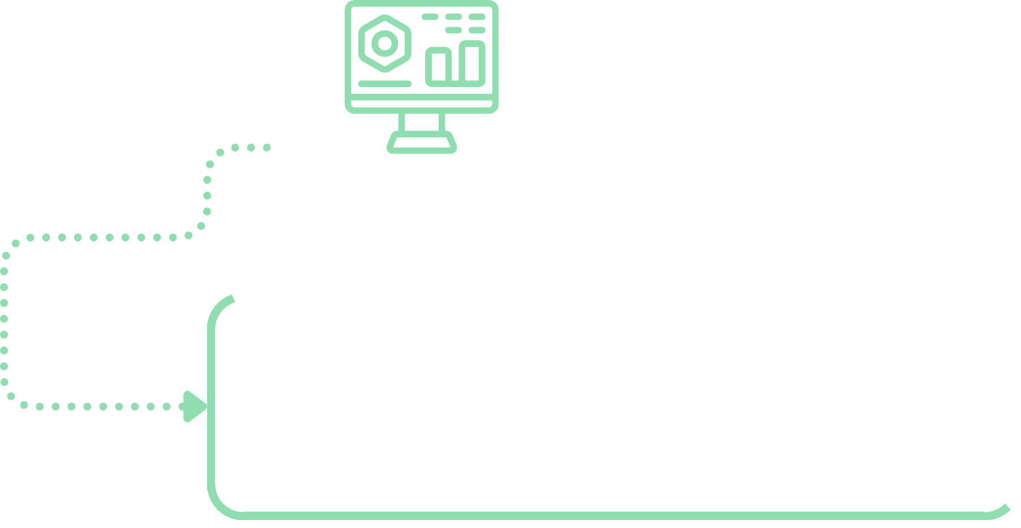



METHODOLOGY
The methodology employed for cyberbullying detection in social media platforms represents a structured and systematic approach. The primary objective is to identify different kinds of comments written in Telugu transliterated in English using a combination of machine learning algorithms, and data preprocessing methods.
Dataset Preparation Model training and implementation
In our project, we carefully collected a Telugu dataset of 3632 comments from social media and Google Forms, ensuring an equal balance of 1816 negative and positive comments. Each comment was categorized as either positive (1) or negative (0). We also gathered diverse examples to enrich our dataset for comprehensive analysis.
It is the process of distinguishing and picking the most significant information from a dataset. It is basically like filtering the essential elements, helping to interpret and highlight the key aspects while extracting out less meaningful details. It represents a method of directing attention towards the essential aspects of the data.
Data Preprocessing
Model testing and categorization.
Data preprocessing involves organizing and preparing primary data for machine learning models, making it a crucial initial step. Structured data isn't always available, so cleaning and encoding it is necessary for various data tasks. Hence, we employ Data Preprocessing.
Model testing and categorization.involves dataset into different classes, whether
classifying a structured or
unstructured, based on anticipated classes. Our goal is to determine the appropriate category for new data inputs

Slide 11
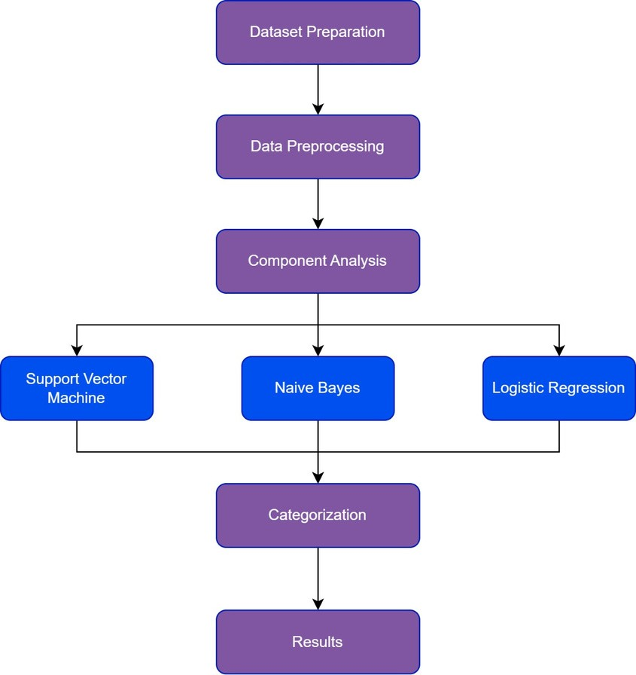
MACHINE LEARNING ALGORITHMS
1. Support Vector Machines (SVM):
SVMs are widely used in AI for binary classification tasks, creating optimal decision boundaries to separate dataset elements.
They excel in complex datasets by maximizing the margin, promoting clear
class distinction, and handling nonlinear separations using kernel functions.
Logistic Regression:
Logistic regression predicts binary outcomes based on predictor factors, generating a probability score bounded between 0 and 1.
It is effective for categorical response variables with two possible outcomes, making it useful for classification and risk assessment tasks.
Naïve Bayes (NB):
NB classifiers assume feature independence given the class, making them efficient for high-dimensional data with limited training samples.
NB is competitive with advanced methods and finds applications in spam filtering, medical diagnosis, image processing, and vocal emotion detection.
Fig 1: Flow chart

Slide 12

RESULTS
This study aimed to evaluate the effectiveness of Support Vector Machine (SVM), Naïve Bayes, and Logistic Regression in detecting instances of cyberbullying.
SVM demonstrated the highest precision (89%) among the models, accurately identifying cyberbullying comments 85% of the time and achieving a recall of 96%.
Naïve Bayes also performed well with a precision of 85%, albeit with slightly lower recall and F1-Score compared to SVM.
Logistic Regression, despite lower overall accuracy (85%), showed strong precision and reasonable recall for cyberbullying detection.
The findings highlight the effectiveness of SVM in accurately detecting cyberbullying, followed by Naïve Bayes and Logistic Regression.
Further refinement and evaluation of these models are essential to enhance their suitability for detecting cyberbullying behaviors in online environments.
The study utilizes confusion matrices and ROC curves to evaluate and visualize the performance of these classifiers.

Slide 13
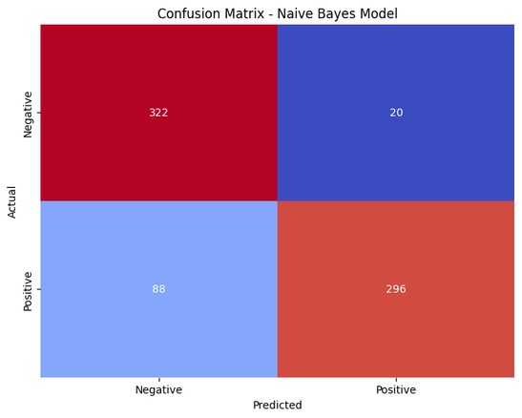
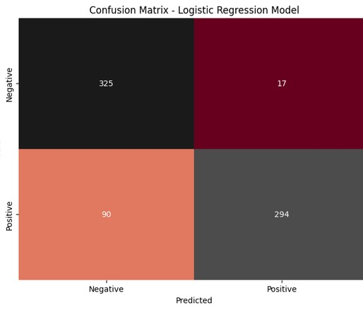
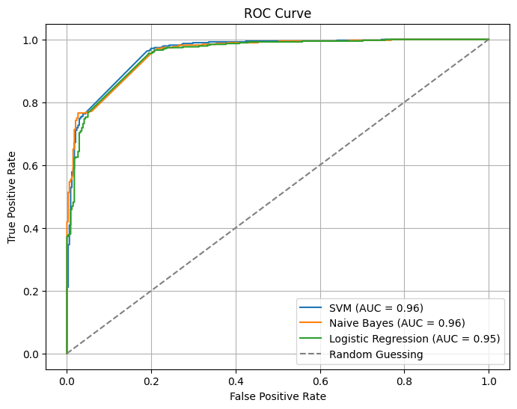
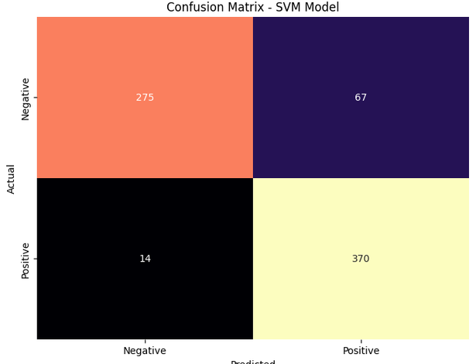
Fig 3: ROC Curve of Classifier
Fig 2: Confusion Matrixes of Classifiers

Slide 14


CONCLUSION
The primary objective of cyberbullying detection on social media platforms is to promptly identify and address instances of cyberbullying, thereby fostering a safer online environment and protecting users from psychological distress and potential harm.
Given the limited research available on the Telugu language transliterated into English text, we constructed our own dataset by collecting social media comments from various platforms.
In our research study, we assessed the effectiveness of three machine learning models—Support Vector Machine (SVM), Naïve Bayes, and Logistic Regression—for cyberbullying detection.
SVM demonstrated superior accuracy and performance, characterized by robust precision, recall, and F1-Score values.
Naïve Bayes also exhibited commendable performance, while Logistic Regression showed respectable effectiveness despite its lower accuracy rate.
Overall, SVM emerged as the most effective model for identifying cyberbullying, emphasizing its relevance and utility in addressing diverse cyberbullying detection scenarios and contributing to the enhancement of online safety and well-being.

Slide 15



FUTURE SCOPE
02
01
03
Multiclassification
As we can use multiclassification of
the comments based on the intensity of the comments with various classes
Multi-Language
Implementation
Currently, our work is mainly based on the Telugu language dataset, and we are interested in continuing our work in more regional languages.
for instance sarcasm, vulgar, racial,
We are looking forward for deploying our work to design a real- time application where we can use it social media, online games, educational sector etc.
and so on where we use binary classification in our present research work.

Slide 16
REFERENCES
Mitushi Raj, Samridhi Singh, Kanishka Solanki, Ramani Selvambi, "An Application to Detect cyberbullying using Machine learning and Deep learning Techniques," In Springer Nature, 2022.
Aditya Desai, Shashank Kalaskar, Omkar Kumbhar, and Rashmi Dhumal. "Cyber bullying Detection on Social Media using Machine Learning," In Informatics and mathematics web of conferences, 2021.
B Nandhini and JI Sheeba. "Cyberbullying detection and classification using information retrieval algorithm," In 2015 International Conference on Advanced Research in Computer Science Engineering & Technology (ICARCSET 2015), p. 20, ACM, 2015.
Walisa Romsaiyud, Kodchakorn na Nakornphanom, Pimpaka Prasertsilp, Piyaporn Nurarak, and Pirom Konglerd. "Automated cyberbullying detection using clustering appearance patterns," In 9th International Conference on Knowledge and Smart Technology (KST), pp. 242–247, 2017.
Shane Murnion, William J Buchanan, Adrian Smales, and Gordon Russell. "Machine learning and semantic analysis of in-game chat for cyberbullying," Computers & Security, vol. 76, pp. 197–213, 2018.
Steven Loria, P Keen, M Honnibal, R Yankovsky, D Karesh, E Dempsey, et al. "Textblob: simplified text processing," in TextBlob:
Simplified Text Processing, 2014
Maral Dadvar, Dolf Trieschnigg, and Franciska de Jong. "Experts and machines against bullies: A hybrid approach to detect cyberbullies," in Proceeding Canadian Conference on Artificial Intelligence, pp. 275–281, 2014.

Slide 17
Maral Dadvar, Dolf Trieschnigg, Roeland Ordelman, and Franciska de Jong. "Improving cyberbullying detection with user context," In European Confernece in Information Retrieval, pp. 693–696, 2013.
Harsh Dani, Jundong Li, and Huan Liu. "Sentiment informed cyberbullying detection in social media," in Proceeding Joint European Conference Machine Learning and Knowledge Discovery Databases, pp. 52–67, 2017.
I-Hsien Ting, Wun Sheng Liou, Dario Liberona, Shyue-Liang Wang, and Giovanny Mauricio Tarazona Bermudez. "Towards the detection of cyberbullying based on social network mining techniques," In Proceeding International Conference on Behavioral, Economic Socio-cultural Computing (BESC), pp. 1–2, 2017.
Rui Zhao, Anna Zhou, and Kezhi Mao. "Automatic detection of cyberbullying on social networks based on bullying features," In Proceeding of 17th International Conference on distributed Computing and Networking, p. 43, 2016.
Sani Muhamad Isa, Livia Ashianti, et al. "Cyberbullying classification using text mining," In 1st International Conference Informatics and Computer Sciences (ICICoS), pp. 241–246, 2017.
Xiang Zhang, Jonathan Tong, Nishant Vishwamitra, Elizabeth Whittaker, Joseph P Mazer, Robin Kowalski, Hongxin Hu, Feng Luo, Jamie Macbeth, and Edward Dillon"Cyberbullying detection with a pronunciation based convolutional neural network," In Proceeding 15th IEEE International Conference on Machine Learning and Applications (ICMLA), pp. 740–745, 2016.
Chikashi Nobata, Joel Tetreault, Achint Thomas, Yashar Mehdad, and Yi Chang. "Abusive language detection in online user content," In Advances on 25th International Conference World Wide Web, pp. 145–153, 2016.
Vikas S Chavan and SS Shylaja. "Machine learning approach for detection of cyber-aggressive comments by peers on social media network," In Advances in computing, communications and Informatics (ICACCI), pp. 2354–2358, 2015.

Slide 18
Lovely Pofessional University | 2024
THANK YOU

